Slide 1
Movie Rating Website

Slide 2
Installation
Check for python installation
> python --version
Python 3.8.0

Slide 3
Setup a virtual environment
Create a folder structure for your project –
> mkdir movie_rating
> cd movie_rating
> py -m venv venv
.\venv\Scripts\activate

Slide 4
Install Flask
Install Flask
> pip install Flask
Collecting Flask
Downloading….
….
….
….

Slide 5
Checkpoint: Does everything work?
Create a file app.py in the server folder
> set FLASK_APP=app.py
> set FLASK_ENV=development
> flask run
from flask import Flask
app = Flask(__name__)
@app.route('/')
def index():
return "Working!!!"

Slide 6
Lets get to our app
List movie names, with ratings (0 - 5)
You should be able to change the rating from the UI.

Slide 7
Define routes
Get the list of movies : GET /
Get the movie with movie id : GET /movie/<movie id>
Set the rating for movie : GET /movie/<movie id>?rating=<value>

Slide 8
Define routes
from flask import Flask, request, escape
app = Flask(__name__)
@app.route('/', methods=['GET'])
def index():
return "Get List of movies"
@app.route('/movie/<int:movie_id>', methods=['GET'])
def update_movie(movie_id):
rating = request.args.get("rating")
return f"updating movie id {escape(movie_id)} with {escape(rating)}"

Slide 9
Check point : Does the newly defined routes work?

Slide 10
Our movie database
[
{
"id": 1,
"name": "Frozen II",
"rating": 4
},
{
"id": 2,
"name": "Ford v Ferrari",
"rating": 5
},
{
"id": 3,
"name": "Kaidhi",
"rating": "4.0"
}
]
Create a file moviedb.json inside your app folder.
Add some movies as per the shown schema

Slide 11
Create a database layer
Create a file moviedb.py
Implement a class with following functions.
Get all movies from the database.
Get a movie from the database, given id as input.
Update the movie data, when rating is given as input.

Slide 12
Hook up your routes to database layer
Change index method to call the database layer and list all movies.
Change the update_movie method, to call the database layer to update with the new rating.

Slide 13
moviedb.py
import json
class MovieDB:
def __init__(self, db_path):
with open (db_path) as db:
self.db_path = db_path
self.movie_data = json.load(db)
def get_movie(self, id):
my_movie = [movie for movie in self.movie_data if movie["id"] == id]
return my_movie[0]
def get_movies(self):
return self.movie_data
def update_movie(self, movie):
movie_to_update = self.get_movie(movie["id"])
movie_to_update["name"] = movie["name"]
movie_to_update["rating"] = movie["rating"]
with open (self.db_path, 'w') as db:
json.dump(self.movie_data,db)

Slide 14
app.py
from flask import Flask, request, escape, jsonify
from moviedb import MovieDB
app = Flask(__name__)
@app.route('/', methods=['GET'])
def index():
movies = MovieDB("./moviedb.json")
return jsonify(movies.get_movies())
@app.route('/movie/<int:movie_id>', methods=['GET'])
def update_movie(movie_id):
moviedb = MovieDB("./moviedb.json")
movie = moviedb.get_movie(movie_id)
rating = request.args.get("rating")
if(rating):
movie["rating"] = float(rating)
moviedb.update_movie(movie)
return jsonify(movie)

Slide 15
Check point : Does the apis work as expected?

Slide 16
Your backend is now ready!!!

Slide 17
Front end
Create folder templates inside your app folder.
Use template inheritance for modular templates.
base.html will serve as the layout for our website.
movies.html will serve as the primary ui for our website.
Notes:
Templates folder is where all your html is going to be.

Slide 18
templates\base.html
<!DOCTYPE html>
<head>
<title> My Movie List</title>
</head>
<header> </header>
<body>
{% block content_block %} {% endblock %}
</body>
<footer> </footer>

Slide 19
templates\movies.html
{% extends "base.html" %}
{% block content_block %}
<h1>Templates are working!!!</h1>
{% endblock %}
Notes:
With this

Slide 20
app.py
from flask import Flask, render_template
@app.route('/', methods=['GET'])
def index():
return render_template('movies.html')
Notes:
With this

Slide 21
Checkpoint : Does the template render properly?

Slide 22
app.py
def index():
moviedb = MovieDB("./moviedb.json")
return render_template('movies.html', movies = moviedb.get_movies())

Slide 23
Setup a display for movie list
{% extends "base.html" %}
{% block content_block %}
<table>
<tr>
<th>Movie Name</th>
<th>My Rating </th>
</tr>
{% for movie in movies %}
<tr>
<td> {{movie.name}} </td>
<td> {{movie.rating}} </td>
</tr>
{% endfor %}
</table>
{% endblock %}
Notes:
How do you get the movie data to your view?

Slide 24
Checkpoint : Did the movie list appear?

Slide 25
Lets edit the rating….
Create a static folder inside app folder.
Create a eventhandler.js that will handle interactivity.
Edit the head section of base.html to include the required javascript.

Slide 26
base.html
<!DOCTYPE html>
<head>
<title> My Movie List</title>
<script src="https://code.jquery.com/jquery-3.4.1.js" crossorigin="anonymous"></script>
<script src="{{ url_for('static', filename='eventhandler.js') }}"></script>
</head>
<header> </header>
<body>
{% block content_block %} {% endblock %}
</body>
<footer> </footer>

Slide 27
eventhandler.js
Create a function that gets called when the rating field is double clicked.
We need an identifier to find if any rating field is clicked, so lets add a class = “rating_cell” for all the rating cells.
$(function () {
$(".rating_cell").dblclick(function (e) {
e.stopPropagation();
alert(“I am double clicked”);
});
});

Slide 28
Checkpoint : Did the alert appear on double click?

Slide 29
eventhandler.js
Get the current value in the rating field.
Replace the current rating field with an input box.
Put the current rating value in the input box.
Set the focus to the current text box.

Slide 30
eventhandler.js
$(function () {
$(".rating_cell").dblclick(function (e) {
e.stopPropagation();
var originalElement = $(this);
var originalValue = $(this).html().trim();
$(this).html('<input id="input_box"
type="text"
value="' + originalValue + '"/>');
$("#input_box").focus();
});
});

Slide 31
eventhandler.js
If the user hits enter, replace the input box with the value in input box.
If the user clicks anywhere in the document, replace the input box with the value in input box.

Slide 32
eventhandler.js
$("#input_box").keyup( function(event){
if(event.keyCode == 13) {
var newRating = $(this).val().trim();
originalElement.html(newRating);
}
});
$(document).click(function() {
if($("#input_box").val()){
var newRating = $("#input_box").val().trim();
originalElement.html(newRating);
}
});

Slide 33
Checkpoint : Does your user interface accept new rating?

Slide 34
Send the new rating to database
Make an ajax call to the api we have created earlier.
/movie/<movie id>?rating=<value>.
Lets create a small function to do that..

Slide 35
eventhandler.js
function saveRating(movie_id, rating) {
$.ajax({
url:'/movie/'+ movie_id +'?rating=' + rating,
success : function(data){ }
});
}

Slide 36
Send the new rating to database
Add movie id as the id for the row.
Fetch it using jquery helper.
Use the movie id and rating to make the ajax call.

Slide 37
movies.html
{% block content_block %}
<table>
<tr>
<th>Movie Name</th>
<th>My Rating </th>
</tr>
{% for movie in movies %}
<tr id= {{movie.id}}>
<td> {{movie.name}} </td>
<td class="rating_cell"> {{movie.rating}} </td>
</tr>
{% endfor %}
</table>
{% endblock %}
Eventhandler.js
var movieId = originalElement.parent().attr('id');

Slide 38
Eventhandler.js
$("#input_box").keyup( function(event){
if(event.keyCode == 13) {
var newRating = $(this).val().trim();
originalElement.html(newRating);
saveRating(movieId,newRating);
}
});
$(document).click(function() {
if($("#input_box").val()){
var newRating = $("#input_box").val().trim();
originalElement.html(newRating);
saveRating(movieId,newRating);
}
});

Slide 39
Checkpoint : Do you now have a fully functioning application?

Slide 40
Let’s add a bit of color to the app
Create a movieList.css file in the static folder.
Reference the css file in the base.html file
base.html
<head>
<title> My Movie List</title>
<script src="https://code.jquery.com/jquery-3.4.1.js" ></script>
<script src="{{ url_for('static', filename='eventhandler.js') }}"></script>
<link rel="stylesheet" type="text/css" href="{{url_for('static', filename='movieList.css')}}">
</head>

Slide 41
Styling cont.
Give some random style to the html file, through css.
* {
background-color: burlywood;
}

Slide 42
Checkpoint : Does your application react to CSS?

Slide 43
Styling cont.
Make the table border visible, its easy to adjust.
Make the table fill its container fully.
Make the column with controllable.
Give a fixed width to the columns.

Slide 44
movieList.css
table {
table-layout: fixed;
width: 100%;
border: brown 1px solid;
border-collapse: collapse;
}
tr th:nth-child(1){
width: 70%;
}
tr th:nth-child(2){
width: 30%;
}

Slide 45
Checkpoint : How does your table look?

Slide 46
Styling cont.
Align the contents of the table

Slide 47
movieList.css
th, td {
padding: 20px;
text-align: center;
border: blue 1px solid;
}

Slide 48
Get a better font...
<link href='https://fonts.googleapis.com/css?family=Sunflower' rel='stylesheet'>
th, td {
font-family: 'Sunflower';
padding: 20px;
text-align: center;
border: blue 1px solid;
}
th {
letter-spacing: 2px;
font-size: 22px;
}
td {
font-size: 18px;
letter-spacing: 1px;
}

Slide 49
Checkpoint : How does your table look?

Slide 50
Give some color to your table
th {
letter-spacing: 2px;
font-size: 22px;
background-color:lightsalmon;
}
td {
font-size: 18px;
letter-spacing: 1px;
}

Slide 51
Make it alternate in color
table tr:nth-child(even){
background-color:lightskyblue;
}
table tr:nth-child(odd){
background-color:whitesmoke;
}

Slide 52
Or some gradients
th {
letter-spacing: 2px;
font-size: 22px;
background-color:lightsalmon;
background-image: linear-gradient(lightsalmon, white);
}
td {
font-size: 18px;
letter-spacing: 1px;
background-color:skyblue;
background-image: linear-gradient(skyblue, white);
}

Slide 53
Checkpoint : How does your table look?

Slide 54
Align the table to center
table {
table-layout: fixed;
width: 50%;
border-collapse: collapse;
margin-left: auto;
margin-right: auto;
}

Slide 55
Give a dark background
html{
background-color: black;
}

Slide 56
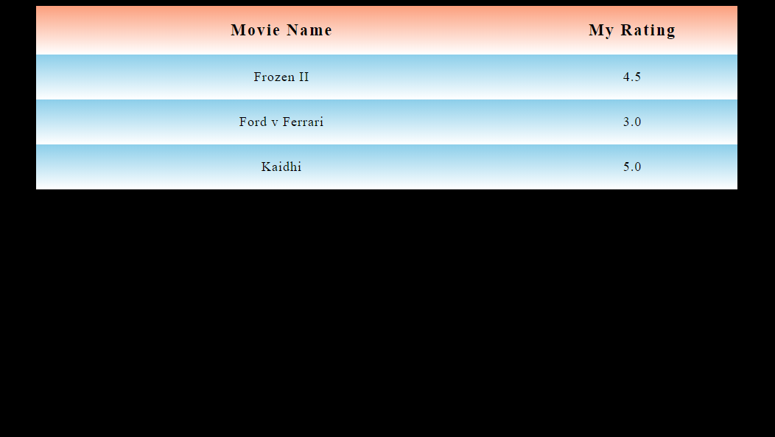

Slide 57
Thank You!!!

